Slide 1
Robot Cognition
Team Toucan
Critical Design Review
Sponsor: Bill Michael
Faculty Sponsor: Leslie Tekamp
10-7-2022

Slide 2
Contents
Description of Design
Design Drawings
Electrical Connections
Test Plan
Software Design Plan

Slide 3
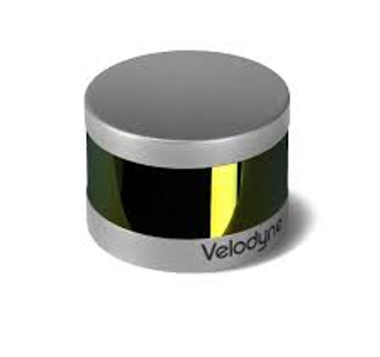
Design Description
The goal of this project is to create a platform that can incorporate sensors to allow for the mapping of its surrounding area.
Sensors that will be used are:
GPS
Inertial Measurement Unit (IMU)
LIDAR
Camera
The platform must weigh less than 5kg
Formats data into a single processing system

Slide 4
Major Hardware
Processor: NVIDIA Jetson Nano
Integrate the following onto one platform:
Xsens MTI-10-2A8G4 (Inertial measurement unit)
Ublox LEA-M8T with WD22UGRC interface board (Global positioning system)
Velodyne LiDAR PUCK 16 (LIDAR)
e-CAM24_CUNX (Camera)
18-36V LIPO battery

Slide 5
Component Weights
Weights do not include cables
3.69 kg remaining
Total Component Weight
Item | Weight (g)
LIDAR | 849
GPS + Antenna | 97
NANO | 269
Camera | 37
Cased IMU | 56
Total | 1308

Slide 6
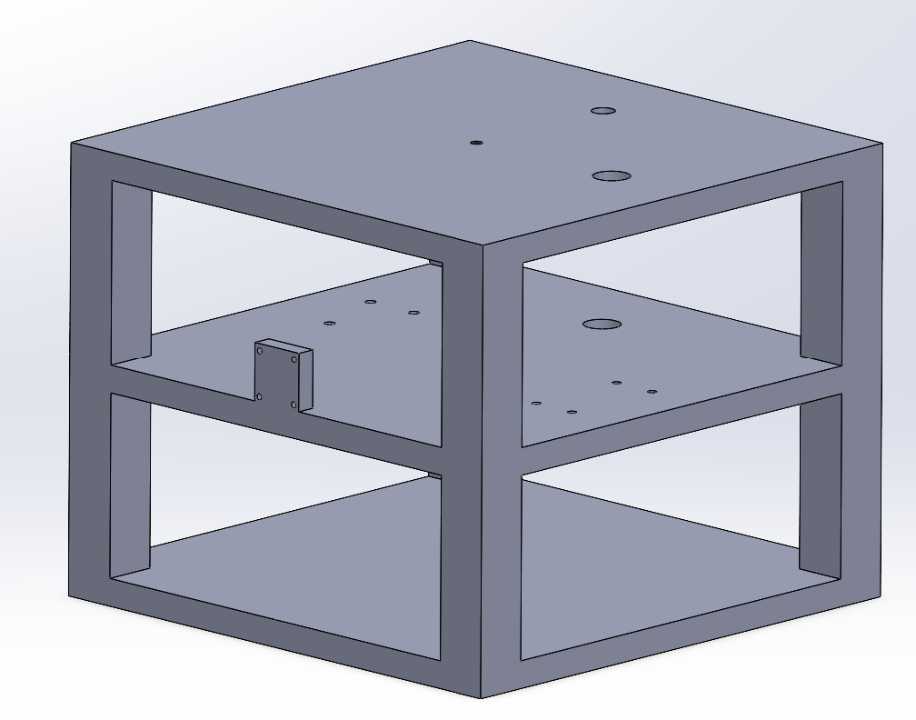
3D Model

Slide 7
3D Model cont.

Slide 8
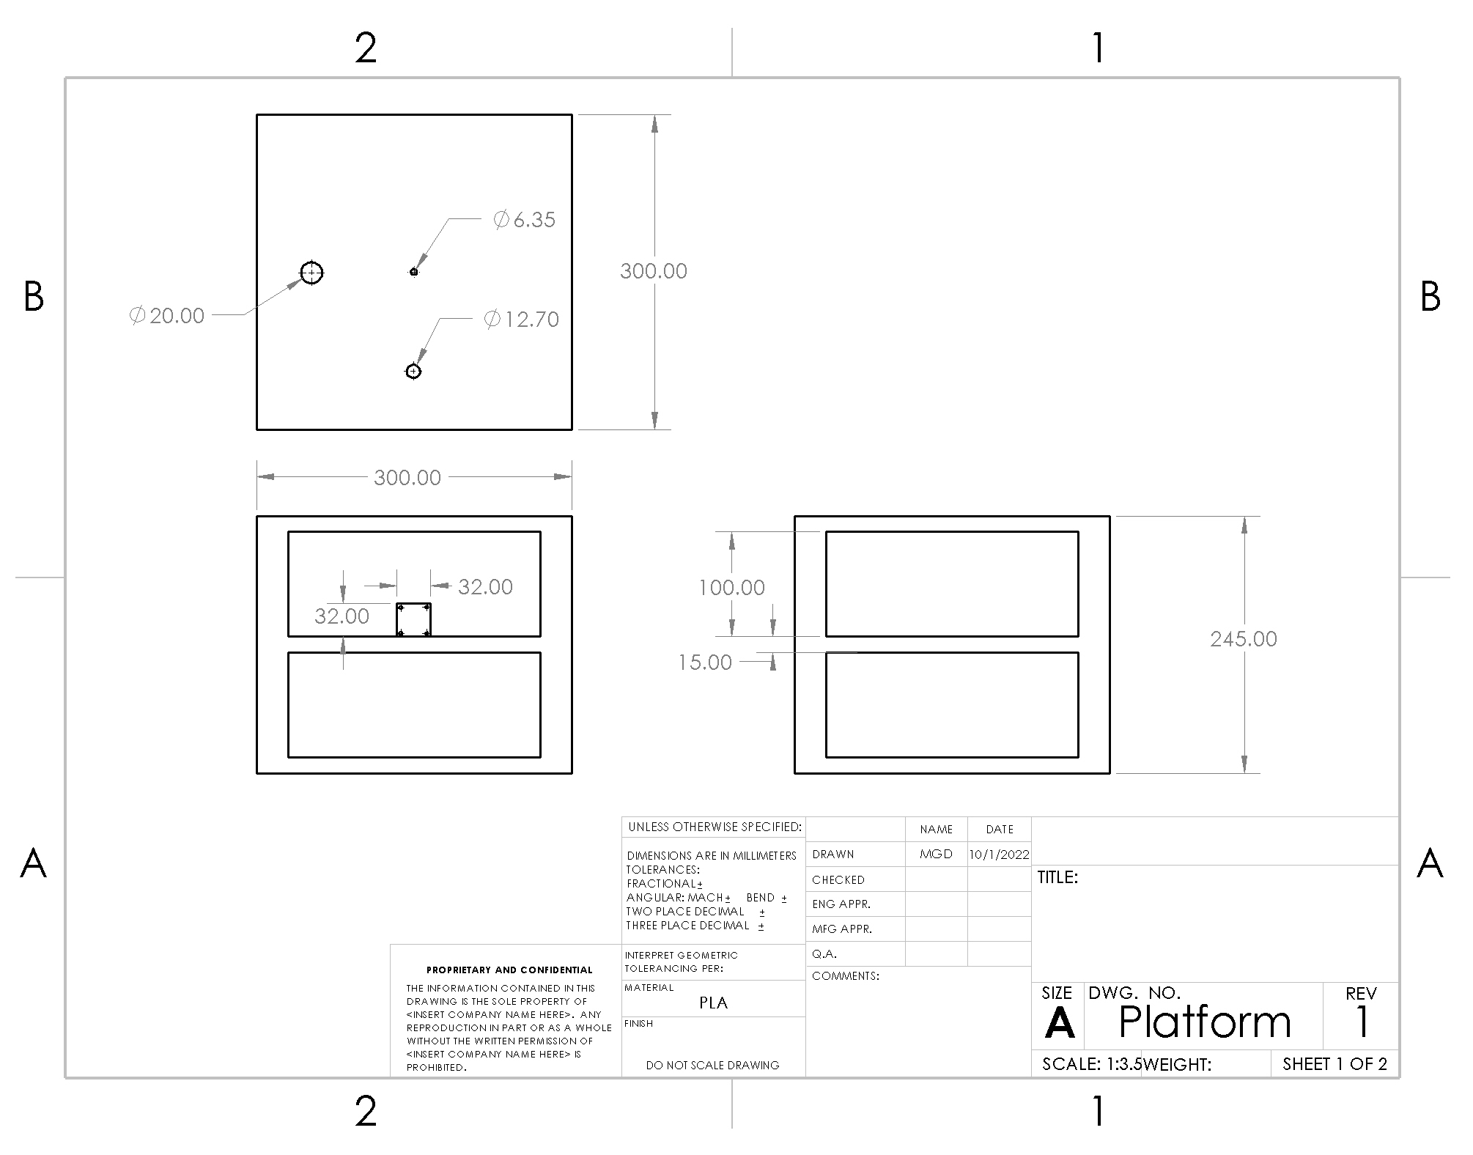
Design Drawings

Slide 9
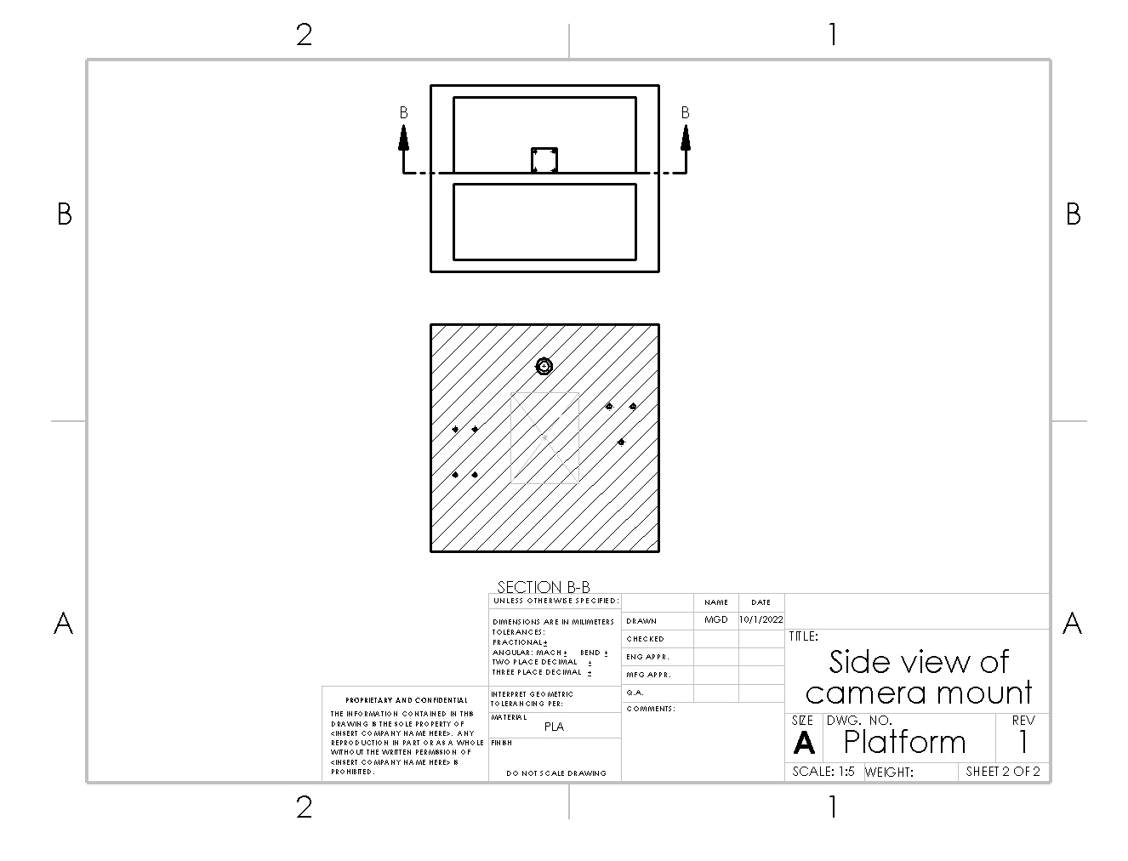
Design Drawings cont.

Slide 10
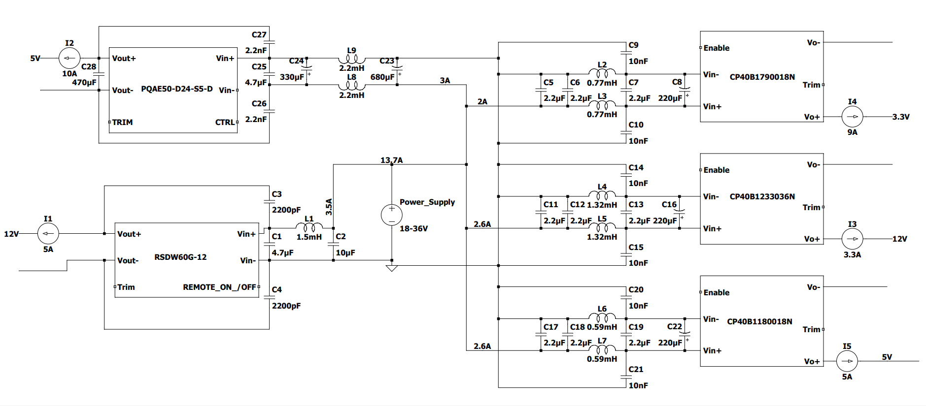
Electrical Connections

Slide 11
DC/DC Isolated Converters

Slide 12
To meet Class B compliance for EN55032

Slide 13
Provides Power to Jetson Nano

Slide 14
Provides Power to Lidar

Slide 15
Provides Power to Three Additional Ports

Slide 16
Power Connections
Point A | Point B | # of Connection | Connector
Battery | Wire A (6 AWG) | 2 | EC5
Wire A | CP40B Externals | 6 | Soldered 12 AWG Wire
Wire A | PQAE50 Externals | 2 | Soldered 12 AWG Wire
Wire A | RSDW60G Externals | 2 | Soldered 12 AWG Wire
CP40B Externals | CP40B DC/DC | 6 | Wire Pin Terminal
PQAE50 Externals | PQAE50 DC/DC | 4 | Wire Pin Terminal
RSDW60G Externals | RSDW60G DC/DC | 4 | Wire Pin Terminal
CP40B DC/DC (5V) | Jetson Nano | 2 | Wire Pin Terminal
CP40B DC/DC (12V) | LIDAR | 2 | Soldered 12 AWG Wire
CP40B DC/DC (3.3V) | Port A | 2 | Female to Male Pin Connector
PQAE50 DC/DC (5V) | Port B | 2 | Female to Male Pin Connector
RSDW60G DC/DC (12V) | Port C | 2 | Female to Male Pin Connector

Slide 17
Signal Connections
Point A | Point B | # of Connections | Connector
Jetson Nano | LIDAR | 1 | Ethernet
Jetson Nano | LEA-M8T (GPS) | 3 | UART
Jetson Nano | Xsens MTI-10-2A8G4 (IMU) | 1 | USB
Jetson Nano | e-CAM24_CUNX​ (Camera) | 1 | MIPI CSI-2
LEA-M8T | Antenna | 1 | SMB to TNC Coax

Slide 18
Software Design Plan Introduction
Installation of required Software and interfaces
Building Code and testbenches for interfacing with the I/O components Through their drivers
Learning how to use the TensorRT interfaced through python/C++ for image recognition
Building Code for the robot to perform all customer requirements
Further testing for bugs, quality control of software.
Schedule and deadlines

Slide 19
SDP: Installation of required Software and interfaces
Installation of runtime libraries
Installation of c++, python libraries
Interfaces for python,C++ to interface with TensorRT on the jetson nano
Installation of All I/O Drivers for the I/O components

Slide 20
SDP: Learning how to use the TensorRT interfaced through python/C++ for image recognition
Learning the libraries for python and C++
Writing the first program to run the inference of an image through TensorRT
Testing the percentages of accuracy for different detected objects, ensuring Hardware/Software cohesion
Testing different images with the recognition on the jetson nano with pre trained networks
Building a custom network for the specified customer requirements if needed

Slide 21
Building Code for the robot to perform all customer requirements
Code to Deal with Datapaths (all inputs from I/O Components such as Lidar and Camera)
Code for the controller for navigation, states, and decision making.
Testing in various environments

Slide 22
Test Plan Introduction
Testing is required to ensure that all the individual components are working properly in addition the components all working together properly
Tests ensure that the:
GPS captures accurate positioning data at all locations
IMU captures correct inertial and velocity in all instances
LIDAR and camera captures correct imaging data in any space

Slide 23
Test Plan Methodology and Procedure: GPS
Upon integration, the GPS will be taken to several locations to read coordinates
The coordinates read from the GPS will be compared to coordinates found on Google Maps.
A successful result will yield GPS coordinates within 10 meters of the actual location
An unsuccessful result will yield GPS coordinates that are more than 10 meters away from the actual location

Slide 24
Test Plan Methodology and Procedure: IMU
Upon integration, the IMU will be turned in different ways (ex. Upside down, a 30° angle, 175° angle), taken to different altitudes (ex. Colorado Springs, Denver, Pikes Peak), and moved at different speeds (driven in a car)
Captured data will be analyzed
A successful result will show correct measurement for all attitudes, altitudes, and velocity
An unsuccessful result will be if the measurements do not match the expected values

Slide 25
Test Plan and Methodology: LIDAR and Camera
Upon integration, the LIDAR and camera will be taken to different environments (ex. Classroom, open field, parking lot) to capture imaging data
A successful result of the tests will show the LIDAR and camera accurately imaging each space
An unsuccessful result of the tests will show the LIDAR and camera inaccurately imaging each space

Slide 26
Test Plan Results and Analysis: GPS
Collected data: Coordinate data
Data was chosen because the purpose of the GPS is to provide positional data in the form of longitude and latitude coordinates
The collected data will be compared to data from Google Maps to ensure correctness

Slide 27
Test Plan Results and Analysis: IMU
Collected data: attitude (angle), distance from sea level (meters), and velocity (meters per second)
Data was chosen so that each capability of the IMU can be verified
This data will be compared to manually collected data from Google Maps or attitude readers to ensure correctness

Slide 28
Test Plan Results and Analysis: LIDAR and Camera
Collected data: Visual Imaging
Data was chosen because the purpose of the LIDAR and camera is to provide visuals
The collected data will be compared to team members’ observations of the space to ensure correctness

Slide 29
Bill of Materials
Item | Unit | Quantity | Total | Manufacturer | Description
e-CAM24_CUNX | $154.00 | 1 | $154.00 | e-con Systems | Camera
NVIDIA Jetson Nano | $259.00 | 1 | $259.00 | NVIDIA | processing unit
Velodyne LIDAR PUCK 16 | $4,000.00 | 1 | $4,000.00 | Velodyne LIDAR | LIDAR
MTI-10-2A8G4 | $759.00 | 1 | $759.00 | Xsens | IMU
LEA-M8T | $89.00 | 1 | $89.00 | Ublox | GPS
3D Print Platform |  | 1
HDMI Cable |  | 1
CP40B_1790018 | $26.47 | 1 | $26.47 | Semiconductor Circuits Inc | DC/DC converter
CP40B_1180018 | $26.47 | 1 | $26.47 | Semiconductor Circuits Inc | DC/DC converter
CP40B_1233036 | $28.60 | 1 | $28.60 | Semiconductor Circuits Inc | DC/DC converter
PQAE50-D24-S5-D | $37.57 | 1 | $37.57 | CUI Inc | DC/DC converter
RSDW60G-12 | $63.77 | 1 | $63.77 | Mean Well | DC/DC converter
CA-USB-MTI | $68.00 | 1 | $68.00 | Xsens | IMU Connector
Misc Wires
Total | $5,511.88

Slide 30
Questions?

